Slide 1
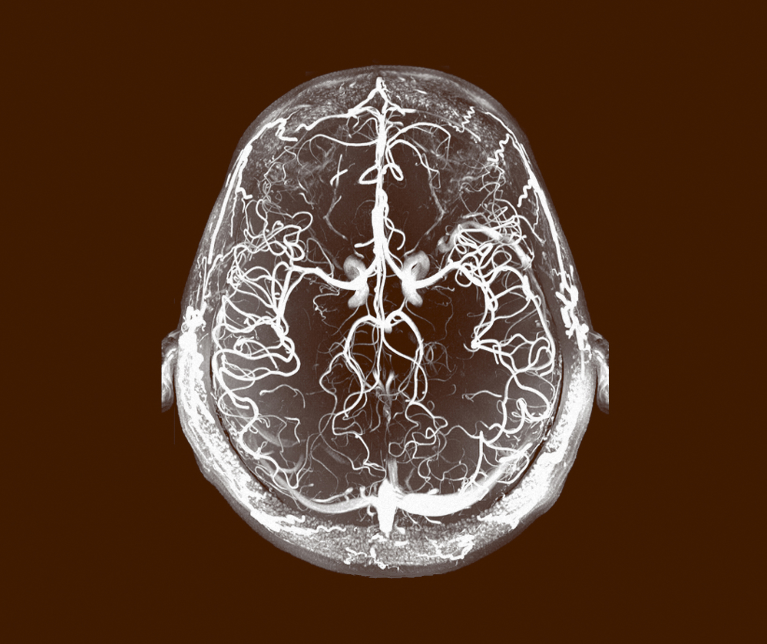
Major depressive disorder (MDD)
Comorbidity

